Slide 1
Exploratory Data Analysis (EDA) for Real Estate Pricing: Unveiling the Dynamics of House Valuation in a Dynamic Market
Created by :- Omkar V. Gosavi

Slide 2
Index
1. Loading the Data:
2. Cleaning the Data:
3. Univariate Analysis:
4. Multivariate Analysis:
5. Feature Engineering:
6. Feature Engineering and Size Impact:
7. Market Trends and Historical Pricing:
8. Customer Preferences and Amenities:

Slide 3
1) Loading the Data:
Load the dataset provided in a CSV or Excel format into a Pandas DataFrame to facilitate easy manipulation and analysis.
Step 1) import pandas as pd.
Step 2) Upload the CSV file by following path:-
df = pd.read_csv(r'C:\Users\HP\Desktop\Project 3\housing_data.csv’)
Step 3) For manipulation and analysis - print(df.head())

Slide 4
2. Cleaning the Data:
Ensure data quality by eliminating missing values, removing duplicate entries, and addressing any anomalies or inconsistencies in the dataset.
Step 1) import pandas as pd.
Step 2) Check for missing values - print(df.isnull().sum())
Step 3) Check for duplicates - print(df_cleaned.duplicated().sum())
Step 4) finding anomalies - df['LotArea'].quantile(0.25) / (0.50) / (0.75) / (1.0)

Slide 5
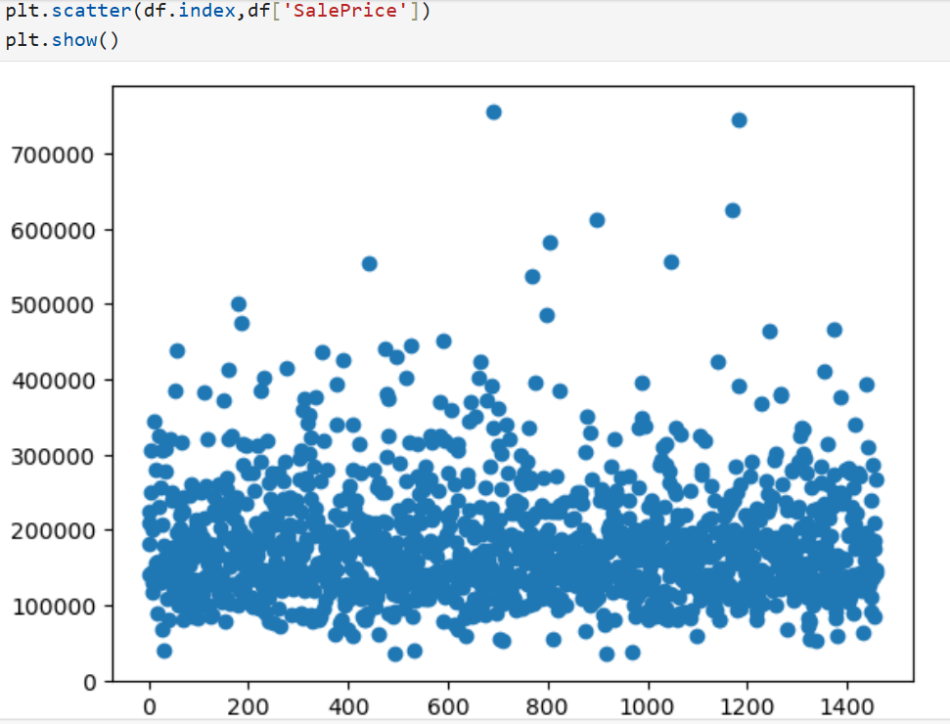
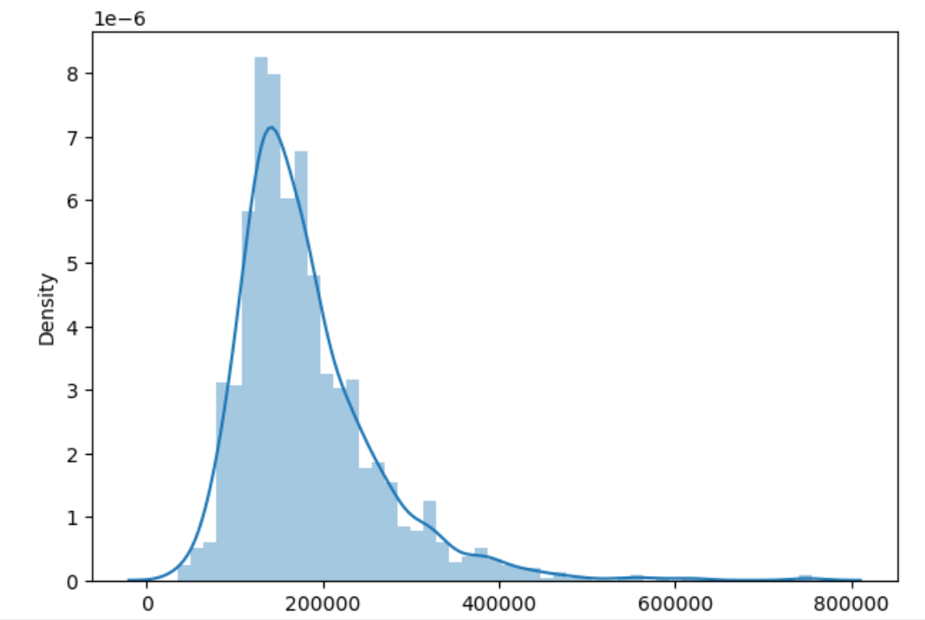
3. Univariate Analysis:
Conduct a univariate analysis to understand the distribution of key variables like house prices. Utilize histograms, kernel density plots, or other visualizations to gain insights into the data.
Scatterplot Distplot

Slide 6
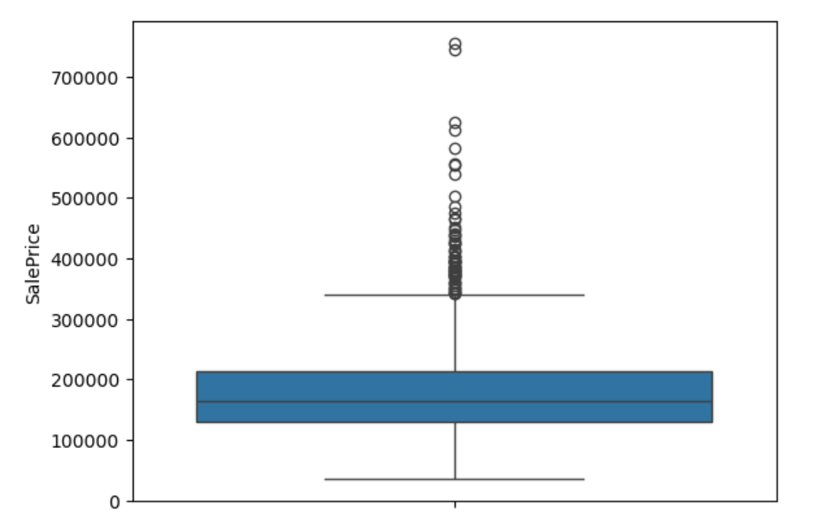
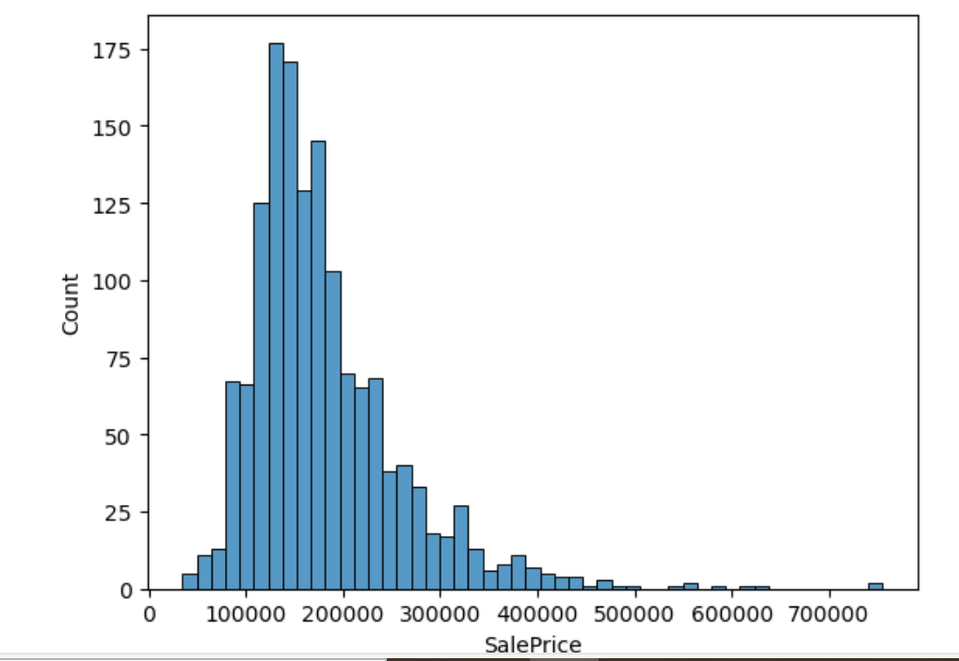
3. Univariate Analysis: Box plot Hist plot

Slide 7
4. Multivariate Analysis:
Perform multivariate analysis to understand the correlations and dependencies between various features. Utilize techniques like correlation matrices or scatterplot matrices for a comprehensive view.
Multivariate analysis can help uncover relationships and dependencies between multiple features in a dataset. Here, I'll demonstrate how to use correlation matrices and scatterplot matrices to perform this analysis using pandas, matplotlib, and seaborn.
Correlation Matrix - A correlation matrix shows the correlation coefficients between variables. It helps identify the strength and direction of relationships.
sns.pairplot(data)
plt.suptitle('Pair Plot of House Prices Dataset', y=1.02)
plt.show()

Slide 8
5. Feature Engineering:
Introduce new variables that might enhance the model's ability to predict house prices. For instance, calculate the price per square foot or engineer a feature representing the property's age.
Price per Square Foot: Calculate the price per square foot to standardize pricing across different property sizes.
Property Age: Engineer a feature that represents the age of the property, which can impact value due to wear and tear or historical significance.
Renovation History: Include information on the last renovation date and the extent of renovations to account for property condition improvements.
Number of Bathrooms and Bedrooms: Add features representing the number of bathrooms and bedrooms, as these directly influence property desirability.
Neighborhood Quality Index: Create an index based on factors like crime rate, school quality, and access to amenities.
Distance to City Center: Measure the distance to the nearest city center or business district, as proximity often affects property value.
Public Transport Access: Include data on the availability and proximity of public transportation options.
View Quality: If available, incorporate a feature for the quality of the view from the property (e.g., ocean view, park view).
Lot Size: Measure the size of the lot in square feet or acres to capture the impact of additional land.
Local Property Taxes: Include property tax rates for the area, as they can influence buyer decisions.
Energy Efficiency: Add features related to the energy efficiency of the property, such as insulation quality, solar panels, and energy-efficient appliances.
Historical Sales Data: Use the historical sales price trend of the specific property, if available.
Seasonal Effects: Capture the time of year when the property was sold, as some seasons may be more favorable for selling homes.
Flood Zone Status: Include a variable indicating whether the property is in a flood zone or other high-risk area.
Homeowner Association (HOA) Fees: If applicable, add the cost of HOA fees, which can impact total ownership cost.
By incorporating these features, you can improve the accuracy and robustness of your house price prediction model.

Slide 9
6. Feature Engineering and Size Impact:
Explore relationships between key features (e.g., number of bedrooms, bathrooms, square footage) and house prices. Identify how these features collectively contribute to the valuation.
Step 1: Data Collection ensure you have a comprehensive dataset with features such as:1) Number of Bedrooms2) Number of Bathrooms3) Square Footage4) House Price.
Step 2: Exploratory Data Analysis (EDA)Perform EDA to visualize and understand the relationships between features and house prices.
Correlation Matrix A correlation matrix helps identify the strength and direction of relationships between features and house prices.

Slide 10
7. Market Trends and Historical Pricing:
Analyze the dataset temporally, looking at trends in house prices over different periods. Understand how external factors, such as economic indicators, may have influenced these trends.
To analyze house prices temporally and understand the influence of external factors, we'll follow these steps:
Data Collection
Gather historical house price data over different periods (e.g., monthly or yearly).
Collect economic indicators such as GDP growth, unemployment rates, inflation rates, interest rates, and other relevant factors.
Data Preprocessing
Clean the data to handle missing values, outliers, and inconsistencies.
Standardize the data format for consistency.

Slide 11
7. Market Trends and Historical Pricing:
Visualization of House Price Trends
Plot house prices over time using line charts to identify trends and seasonal patterns.
Correlation Analysis
Calculate correlations between house prices and economic indicators to identify significant relationships.
Temporal Analysis
Divide the data into different periods (e.g., pre-2008 financial crisis, post-crisis recovery) and analyze trends within each period.
Regression Analysis
Use regression models to quantify the impact of economic indicators on house prices.

Slide 12
8. Customer Preferences and Amenities:
Examine the dataset to understand how specific amenities (e.g., swimming pool, garage) impact house prices. Analyze customer feedback or reviews to gauge the perceived value of these amenities.
Step 1: Data Collection
Gather data on house prices and specific amenities, as well as customer feedback or reviews. This can include:
House Prices: Historical house price data.
Amenities: Information on amenities such as swimming pools, garages, gardens, gyms, etc.
Customer Feedback: Reviews or feedback from buyers or residents, potentially scraped from real estate websites or surveys.
Step 2: Data Preprocessing Clean and preprocess the data to handle missing values, outliers, and inconsistencies. Standardize the data format for consistency.
Step 3: Exploratory Data Analysis (EDA) Perform EDA to understand the relationships between house prices and specific amenities:
Correlation Analysis: Identify correlations between house prices and different amenities.
Visualization: Use scatter plots, histograms, and box plots to visualize trends and distributions.

Slide 13
8. Customer Preferences and Amenities:
Examine the dataset to understand how specific amenities (e.g., swimming pool, garage) impact house prices. Analyze customer feedback or reviews to gauge the perceived value of these amenities.
Step 4: Feature Engineering Create new features that capture the presence or quality of amenities:
Binary Variables: Create binary variables indicating the presence or absence of specific amenities (e.g., swimming pool, garage).
Amenity Scores: Assign scores to properties based on the number and quality of amenities.
Step 5: Regression Analysis Use regression models to quantify the impact of specific amenities on house prices:
Hedonic Pricing Model: This model estimates house prices based on the characteristics of the property and its surrounding environment.
Regression Analysis: Perform regression analysis to determine the significance and impact of different amenities.
Step 6: Sentiment Analysis Analyze customer feedback or reviews to gauge the perceived value of specific amenities:
Text Preprocessing: Clean and preprocess the text data (e.g., removing stop words, stemming, and lemmatization).
Sentiment Analysis: Use sentiment analysis tools to evaluate the sentiment of reviews and identify common themes.
Topic Modeling: Apply topic modeling techniques to uncover recurring topics related to amenities.

Slide 14
Thanks for watching….

